Slide 1
AN EFFICIENT DEEP NEURAL NETWORK’S TRAINING FRAMEWORK FOR ROBUST FACE RECOGNITION
Authors:
Canping Su, Yan Yan, Si Chen, Hanzi Wang
Slides by:
Samin Hamidi, Atefeh Moradan

Slide 2
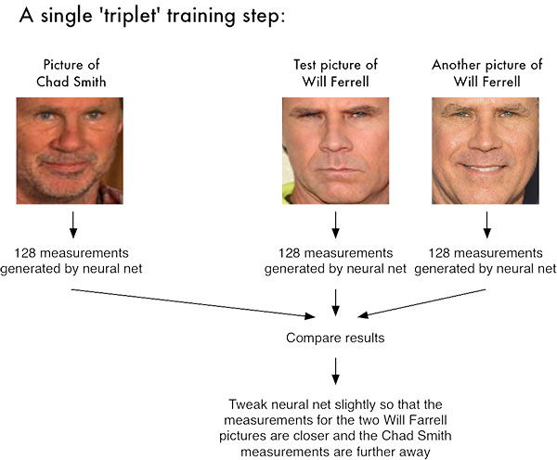
Problem
Triplet loss-based DNN are popular
Training is difficult
due to the difﬁculty in generating high-quality training samples
Notes:
Face net

Slide 3
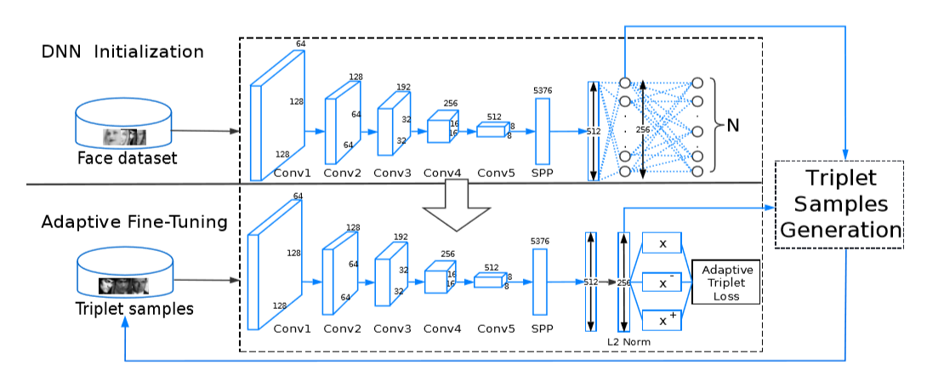
Proposed Framework
1) DNN Initialization
2) Adaptive Fine-Tuning
Notes:
An adaptive triplet loss function vs conventional loss function: characterizes inter-class and intra-class face variations more effectively
An efﬁcient DNN training framework, which advantageously combines the softmax loss and triplet loss to obtain the powerful face representation

Slide 4
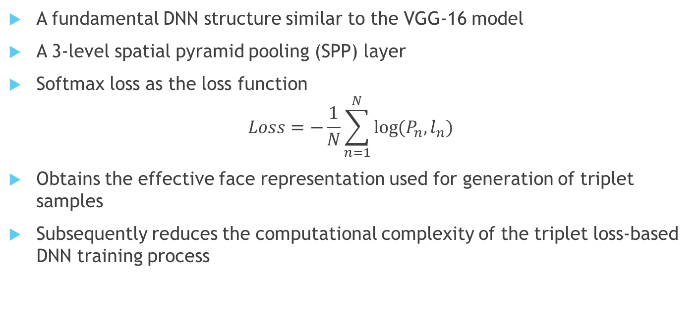
Framework: DNN Initialization
A fundamental DNN structure similar to the VGG-16 model
A 3-level spatial pyramid pooling (SPP) layer
Softmax loss as the loss function
$$Loss=−\frac{1}{N}\sum_{n=1}^{N}{\log{(P_{n},l_{n})}}$$
Obtains the effective face representation used for generation of triplet samples
Subsequently reduces the computational complexity of the triplet loss-based DNN training process
Notes:
Then, the maxout [10] is used instead of the traditional ReLU [11] as the activation function due to its powerfully discriminative ability.
We use a 3-level spatial pyramid pooling (SPP) layer to combine the multi-scale features before the ﬁrst fully-connected layer
Finally, the softmax loss is used as the loss function
N is the number of training samples, and ˆ pn,ln = exp(xn,ln)/K k=1 exp(xn,k) denotes the probability for the n-th sample to be in the ln-th class. K is the number of face classes. xn,ln deﬁnes the output of neuron ln.
DNN initialization based on the softmax loss obtains the effective face representation used for the generation of triplet samples, which can signiﬁcantly reduce the computational complexity of the subsequent triplet loss-based DNN training process.

Slide 5
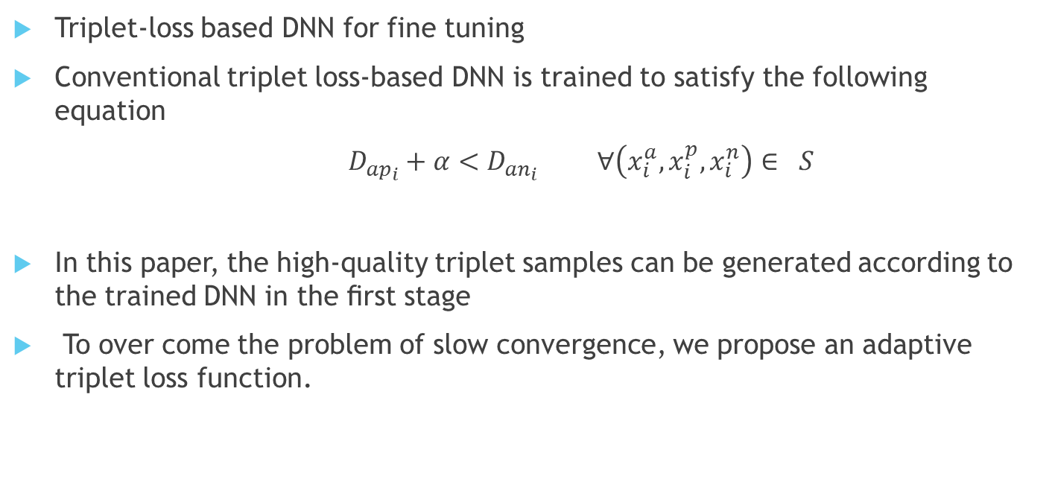
Framework: Adaptive fine-tuning
Triplet-loss based DNN for fine tuning
Conventional triplet loss-based DNN is trained to satisfy the following equation
$D_{{ap}_{i}}+α<D_{{an}_{i}}$ $∀\left(x_{i}^{a}, x_{i}^{p}, x_{i}^{n}\right)∈ S$
In this paper, the high-quality triplet samples can be generated according to the trained DNN in the ﬁrst stage
To over come the problem of slow convergence, we propose an adaptive triplet loss function.
Notes:
The triplet loss-based DNN [4] maps the input face images into a d-dimensional Euclidean space, which aims to shrink the distances of the faces belonging to the same person while enlarging the distances of the faces belonging to different persons.
The performance of the triplet loss-based DNN largely depends on the high-quality training samples
A popular strategy is to directly generate triplet samples in the original image space
Anchor and positive (intra class)
Anchor and negative (inter class)
Alpha is a is a fixed margin
S is the training set
xa i ,xp i and xn i deﬁne the anchor, positive and negative image in the i-th triplet sample, respectively
However, such a strategy cannot effectively generate high quality triplet samples to characterize the underline distributions of face variations.
Compared with the conventional method, the generation of the triplet samples is more easier, and these triplet samples can characterize the face variations more effectively (since the distancesarecomputedinthefeaturespace).

Slide 6

Framework: Adaptive fine-tuning(Cont.)
Loss function of Adaptive Triplet loss-based DNN:
$$Loss= \sum_{i=1}^{N}{max\left(err\left(S_{i}\right), 0\right)}$$
$$err\left(S_{i}\right)={D_{ap}}_{i}+\frac{D_{max}}{\sqrt[n]{D_{{ap}_{i}}}}τ−D_{{an}_{i}}$$
Notes:
Where
Si is the i-th triplet sample in S.
N is the cardinality of training set, and Dmax is the maximal distance among all the positive pairs.
τ is a constant that scales the adaptive margin and n>1 is a scalar to control the enlargement.
Dmaxτ/ n √Dapi is enlarged when Dapi is decreased, which effectively ensures the fast convergence of DNN.

Slide 7
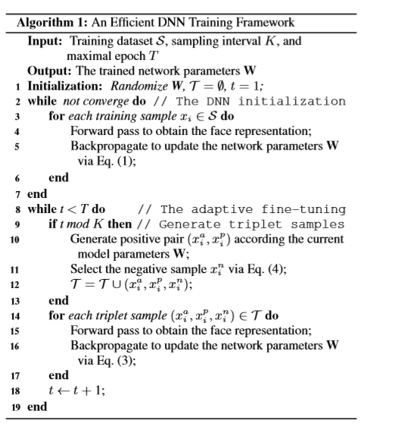

Algorithm

Slide 8
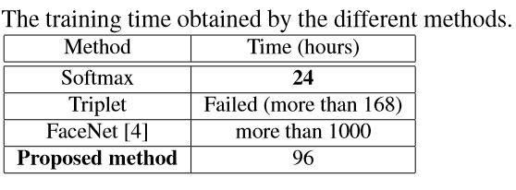
Results: Claim!!!
Experimental results show that, the model obtained by the proposed DNN training framework achieves 97.3% accuracy on the LFW benchmark with low training complexity, which veriﬁes the efﬁciency and effectiveness of the proposed framework.
Notes:
The schematic diagram of the proposed training framework.
Each Conv unit is followed by a 2×2 max-pooling layer with stride 2.
Conv1 to Conv5 has{1, 2, 2, 3, 3}convolutional layers, respectively.
Each convolutional layer is followed by a Maxout layer.
SPP denotes the spatial pyramid pooling layer.
A dropout layer, whose ratio is 0.5, is added after each fully connected layer.

Slide 9

Ambiguities!
Line 10 in the algorithm: How exactly the positive pair is found? It has not been mentioned clearly in the paper

Slide 10
Our proposal!
How to generate triplet samples!
Positive samples:
Assuming we have N classes. We pick one image from each class randomly as the anchor image. We feed into the first NN and softmax gives us a probability of this image belonging to its class, say 60%. Then keep feeding images in each class to the network, saving their probability. Positive pair is the image having the closest probability to the anchor’s probability.

Slide 11
Thank you!

